Slide 1
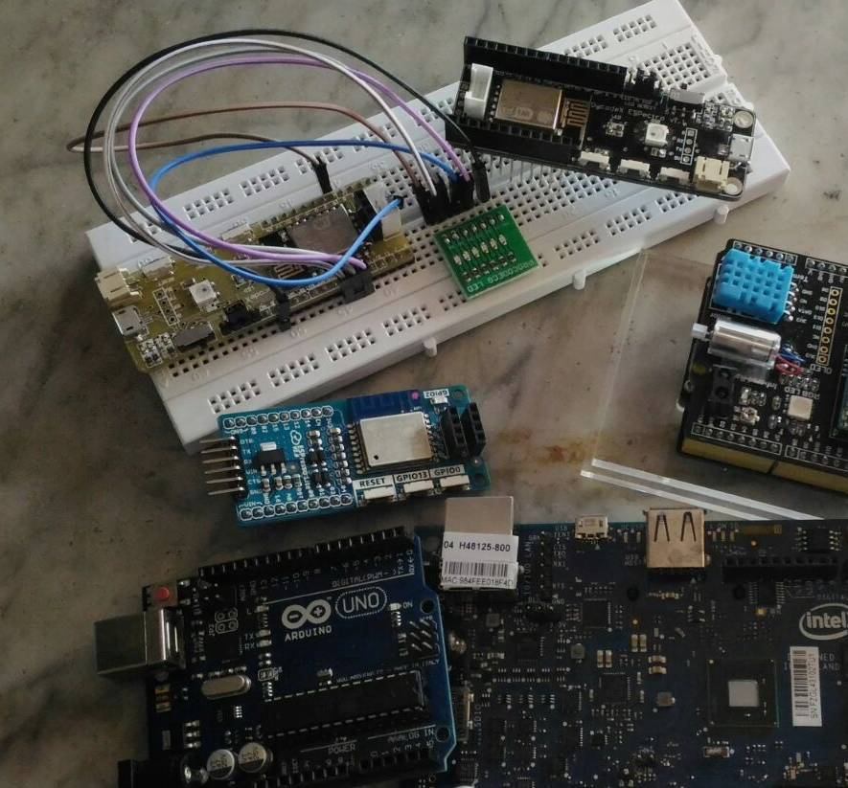
IoT & MQTT theory & practice
Budi Rahardjo
@rahard
2022

Slide 2
What is MQTT
MQ Telemetry Transport
A light-weight protocol originally developed @ IBM
Communication among sensors and devices – Internet of Things (IoT)
Designed for data from a huge number of sensors
Based on Queue: publish & subscribe and a message broker

Slide 3
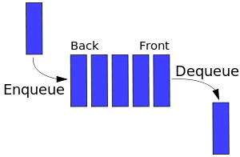
Basic Queue: FIFO (First in, First Out)

Slide 4
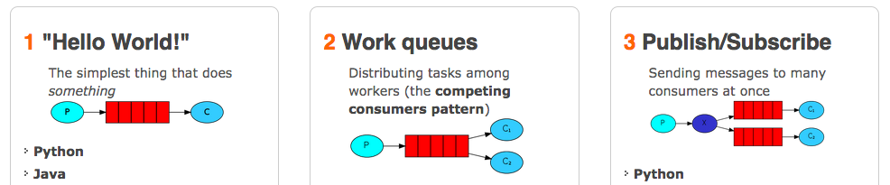
Example: RabbitMQ

Slide 5
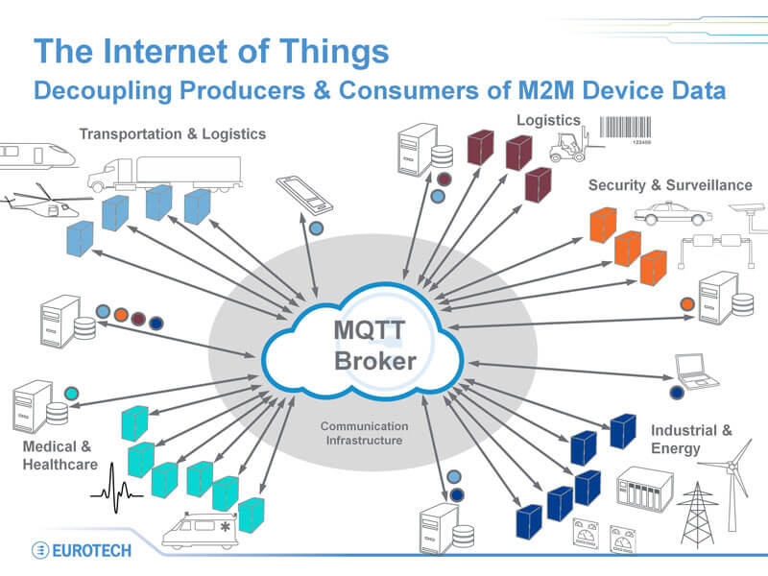

Slide 6
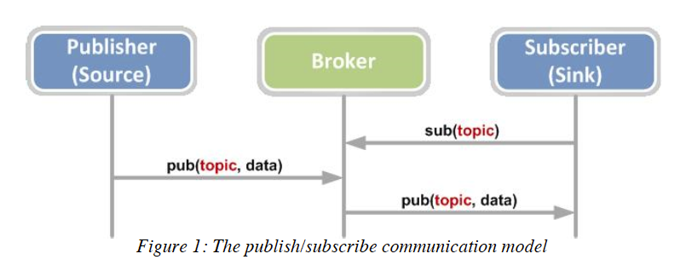
(PubSub) Communication Model

Slide 7
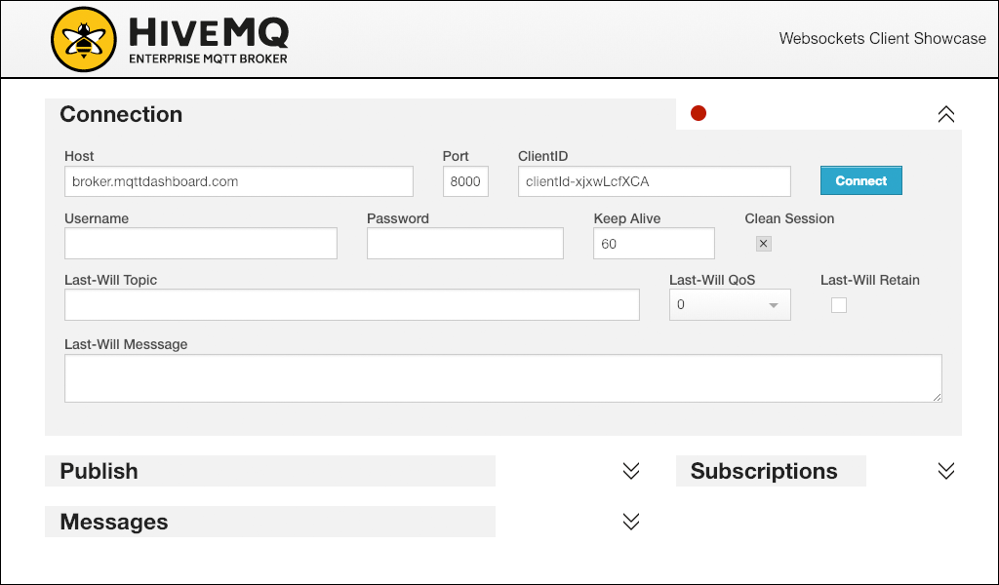
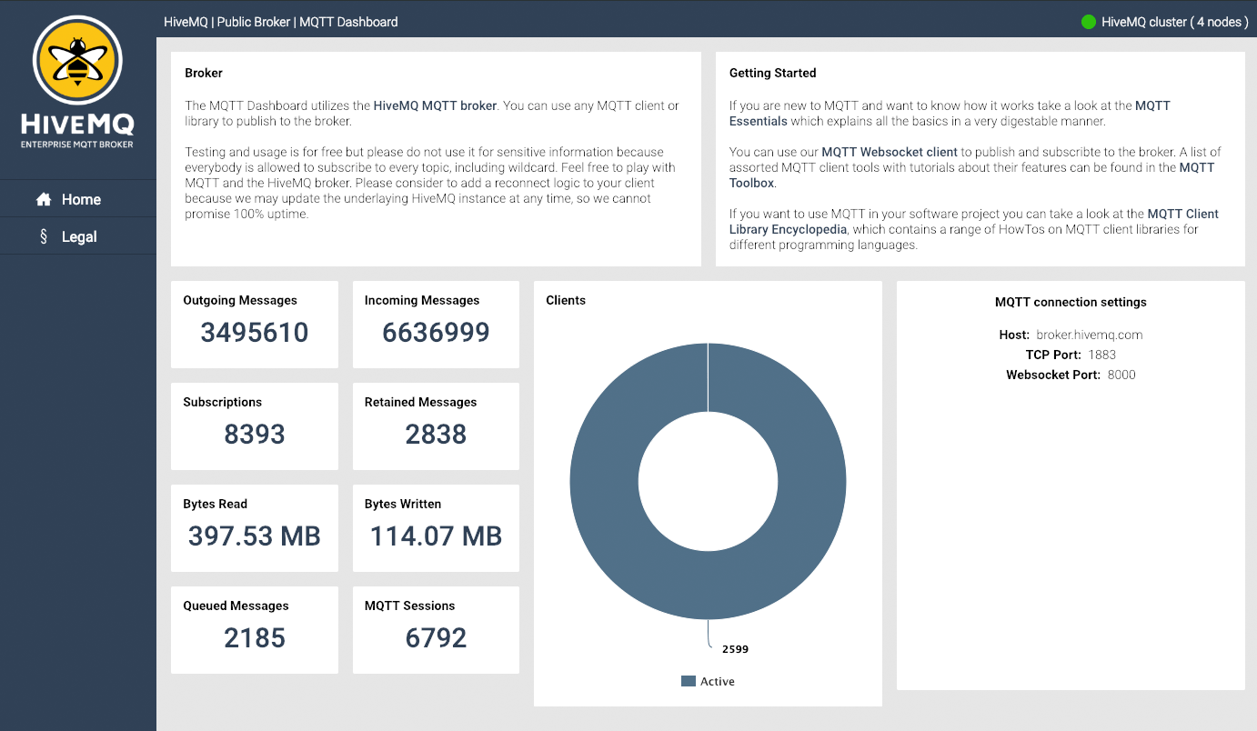
MQTT Brokers
Clouds
IBM, Azure, Amazon
Smaller clouds:
https://mqtthq.com
http://www.hivemq.com
http://www.mqtt-dashboard.com/
http://www.hivemq.com/demos/websocket-client/
Open source
Mosquitto

Slide 8
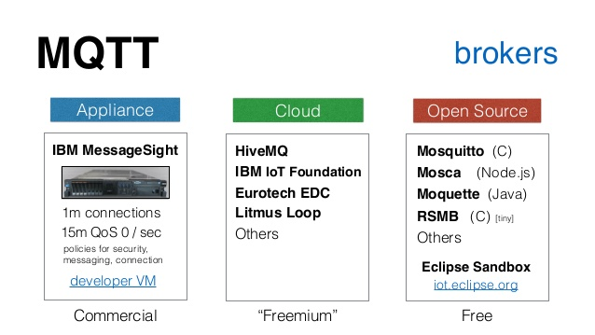
Brokers

Slide 9
Demos

Slide 10
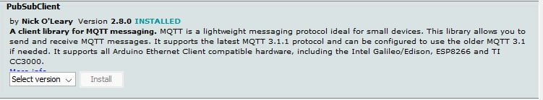
ESP8266 board
Have a look at the code at this Github
https://github.com/rahard/BRiot-stuff/MQTT/mqtt_esp8266.ino
Edit the content (the access point part, MQTT server)
Add libraries (PubSubClient)

Slide 11
Local Broker
Mosquitto (install locally)
unix% mosquitto
IP: 192.168.43.67
Port: 1883
Topic: LED1

Slide 12


Client
Mosquito
mosquitto_sub –h 192.168.4.130 –t “LED1”
GUI: MQTT.fx (now commercial), MQTT X
Python: paho-mqtt
Android: MQTT Dash

Slide 13
PAHO Client (python)
# https://github.com/rahard/BRiot-stuff/blob/master/MQTT/klien-paho.py
import paho.mqtt.client as paho
def on_connect(client, userdata, flags, rc):
print("Connected with result code "+str(rc))
client.subscribe("inTopic")
def on_message(client, userdata, msg):
print(f'topic: {msg.topic} - msg: {msg.payload.decode()}')
client = paho.Client()
client.on_connect = on_connect
client.on_message = on_message
client.connect("mqtt.luqmanr.xyz", 1883, 60)
client.loop_forever()

Slide 14
Publisher
Mosquitto
mosquitto_pub –h 192.168.4.242 –t “LED1” –m “hello world” –q 0 –r
mosquitto_pub –h 192.168.4.242 –t “suhu” –m “23” –q 0 –r
MQTT.fx
IoT: Espectro
Python:

Slide 15
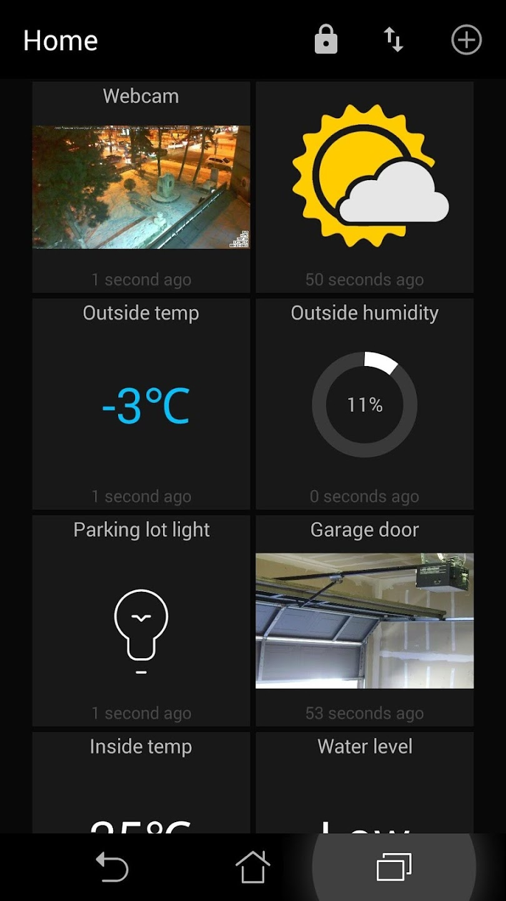
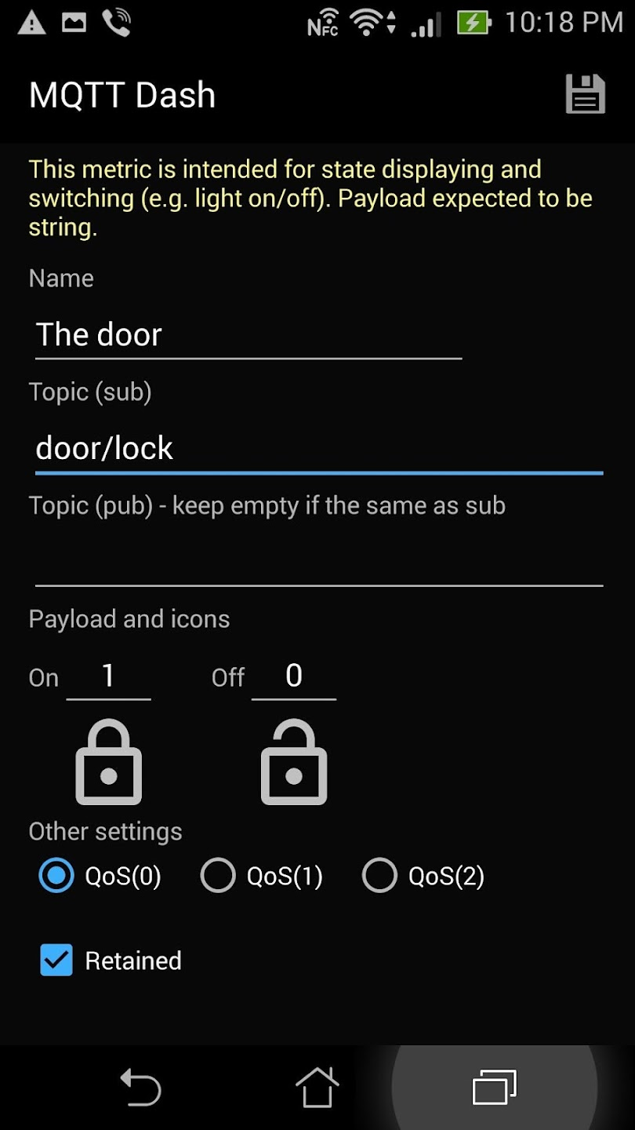
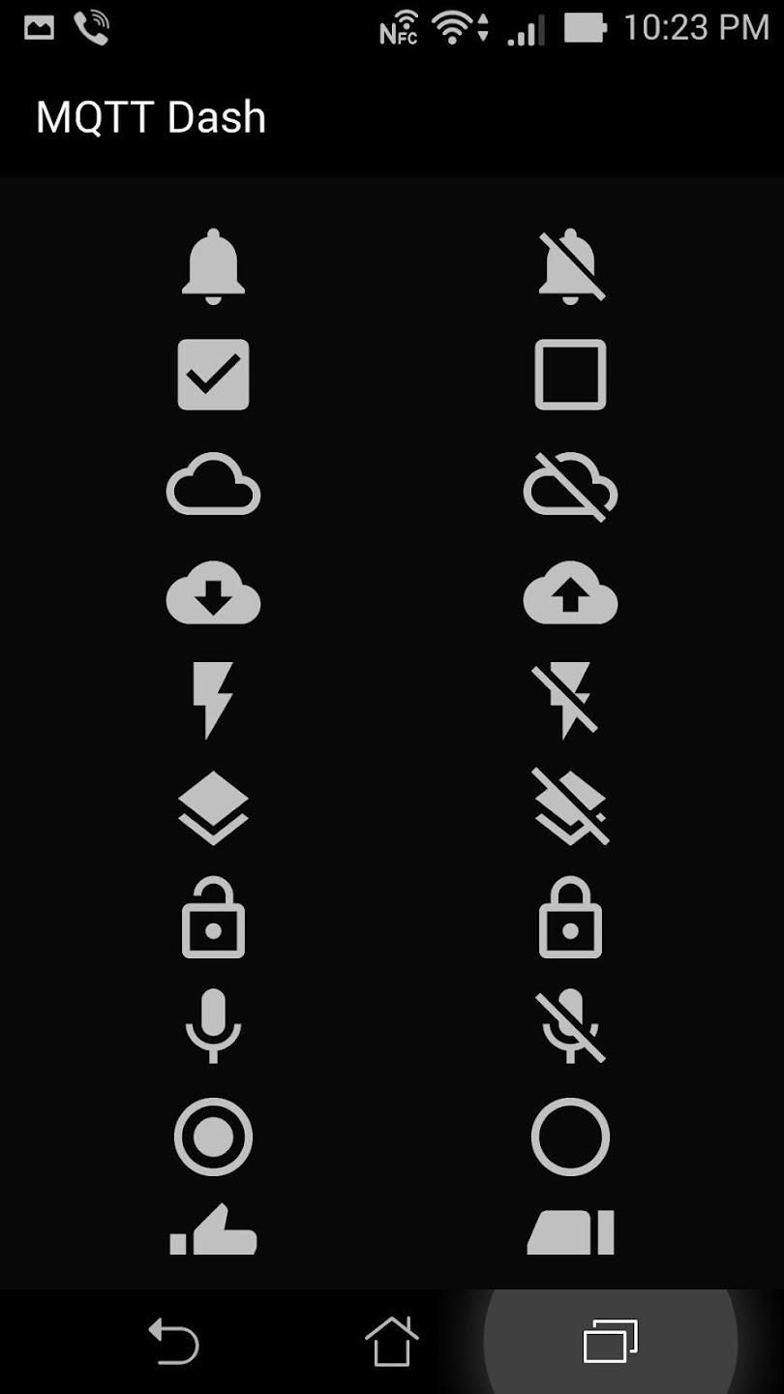
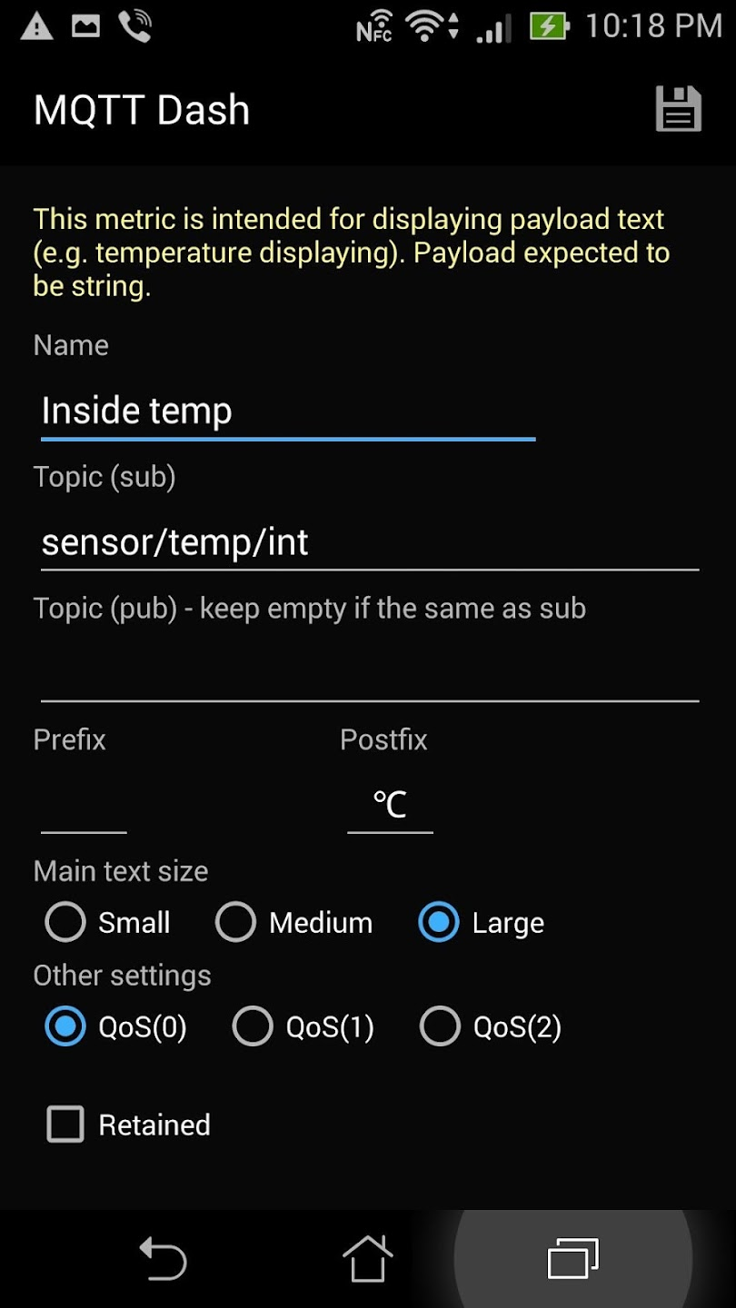
Sesi MQTT Dash (Android)

Slide 16
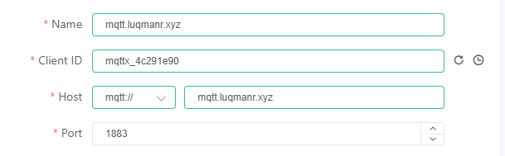
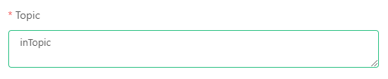
MQTTX Connect Steps
1. Add new Connections (click on [+] button on top left)
2. Select New Connection
3. Enter the configuration like so (randomize Client ID using the ↻ (refresh) icon)
4. Click Connect on the upper right corner
5. Add new Subscription Topic by clicking + New Subscription button
6. Enter Topic name

